Slide 1
CPS 235 Object Oriented Programming Paradigm
Lecturer Rabia Khan
Composition, Inheritance

Slide 2
Contents
Composition (or containership)
  Objects as Members of Classes
Concept of Inheritance
Levels of access control
CPS235:Inheritance

Slide 3
Composition vs Inheritance
Composition – A “has a” relationship
  An employee has a name, id, salary
  Class member data can contain basic data types as well as objects of other classes
  An employee has a date of birth and date of hiring and these can be represented by objects of a date class
Inheritance – A “kind of” or “is a” relationship
  An employee can be a laborer, a scientist, a manager, an engineer
  These are all examples of a more general category of employees
  So a laborer is an employee, so is a scientist and so on…
CPS235:Inheritance

Slide 4
Composition/Containership
Objects as members of a class
CPS235:Inheritance

Slide 5
date1.h (1 of 1)
#include <iostream>
#include<conio>
7 class Date {
8
9 public:
10 Date( int = 1, int = 1, int = 1900 ); // default constructor
11 void print() const; // print date in month/day/year format
~Date(); // destructor
Date (const Date& d); //copy constructor
13
14 private:
15 int month; // 1-12 (January-December)
16 int day; // 1-31 based on month
17 int year; // any year
18
22 }; // end class Date

Slide 6
date1.cpp (1 of 3)
11 Date::Date( int mn, int dy, int yr )
14 {
15 if ( mn > 0 && mn <= 12 ) // validate the month
16 month = mn;
17
18 else { // invalid month set to 1
19 month = 1;
20 cout << "Month " << mn << " invalid. Set to month 1.\n";
21 }
22
23 year = yr; // should validate yr
day = dy;
// output Date object to show when its constructor is called
27 cout << "Date object constructor for date ";
28 print();
29 cout << endl;
30
} // end Date constructor
void Date::print() const
35 {
36 cout << month << '/' << day << '/' << year;
37
38 } // end function print
39
40 // output Date object to show when its destructor is called
41 Date::~Date()
42 {
43 cout << "Date object destructor for date ";
44 print();
cout << endl;
getch();
46
47 } // end destructor ~Date

Slide 7
date1.cpp (2 of 3)
//Copy constructor
Date::Date(const Date& d)
{
month = d.month;
day = d.day;
year = d.year;
cout<<“copy constructor for date object called during copy of date";
print();
cout<<endl;
}

Slide 8
employee1.h (1 of 2)
class Employee {
11 public:
12 Employee(const char [], const char [], const Date &, const 13 Date & ) ;
14
15 void print() const;
16 ~Employee(); // destructor
17
18 private:
19 char firstName[ 25 ];
20 char lastName[ 25 ];
21 const Date birthDate; // composition: member object
22 const Date hireDate; // composition: member object
23
24 }; // end class Employee

Slide 9
employee1.cpp
(2 of 3)
13 // constructor uses member initializer list to pass initializer
14 // values to constructors of member objects birthDate and
// hireDate [Note: This invokes the "default copy constructor“]
17 Employee::Employee( const char first[], const char last[],
18 const Date &dateOfBirth, const Date &dateOfHire )
19 : birthDate( dateOfBirth ), // initialize birthDate
20 hireDate( dateOfHire ) // initialize hireDate
21 {
22 // copy first into firstName and be sure that it fits
23 int length = strlen( first );
24 length = ( length < 25 ? length : 24 );
25 strncpy( firstName, first, length );
26 firstName[ length ] = '\0';
27
28 // copy last into lastName and be sure that it fits
29 length = strlen( last );
30 length = ( length < 25 ? length : 24 );
31 strncpy( lastName, last, length );
32 lastName[ length ] = '\0';
33
34 // output Employee object to show when constructor is called
35 cout << "Employee object constructor: "
36 << firstName << ' ' << lastName << endl; }
Member initializer syntax to initialize Date data members birthDate and hireDate; compiler uses the copy constructor of Date class defined on slide 7
Output to show timing of constructors.

Slide 10
employee1.cpp
(3 of 3)
40 // print Employee object
41 void Employee::print() const
42 {
43 cout << lastName << ", " << firstName << "\nHired: ";
44 hireDate.print();
45 cout << " Birth date: ";
46 birthDate.print();
47 cout << endl;
48
49 } // end function print
50
51 // output Employee object to show when its destructor is called
52 Employee::~Employee()
53 {
54 cout << "Employee object destructor: "
<< lastName << ", " << firstName << endl;
getch();
56
57 } // end destructor ~Employee
Output to show timing of destructors.

Slide 11
fig07_10.cpp
(1 of 1)
#include <iostream>
10 int main()
11 {
12 Date birth( 7, 24, 1949 );
13 Date hire( 3, 12, 1988 );
14 Employee manager( "Bob", "Jones", birth, hire );
getch();
15
16 cout << '\n';
manager.print();
cout<<‘\n’;
Employee clone("Rob", "Jones", birth, hire);
cout<<‘\n’;
clone.print();
getch();
23 return 0;
24
25 } // end main
Create Date objects to pass to Employee constructor.

Slide 12
Order of Destructors in Composition
Objects are constructed from the inside out and destroyed in the reverse order from the outside towards in (i.e. the Date member objects are destroyed after the Employee object that contains them). Keep in mind the reverse order!
Employee
Date

Slide 13
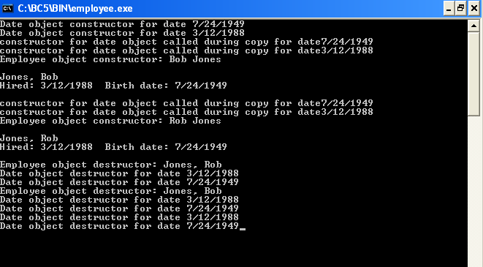
Output
Note two additional Date objects constructed; copy constructor used
Destructor for host object manager runs before destructors for member objects hireDate and birthDate.
Destructor for Employee’s member object hireDate.
Destructor for Employee‘s member object birthDate.
Destructor for Date object hire.
Destructor for Date object birth.
CPS235:Inheritance

Slide 14
Compulsory Reading
Deitel and Deitel (5th edition)
  Topic: 10.3. Composition: Objects as Members of Classes
CPS235:Inheritance

Slide 15
Inheritance
Inheritance is a relationship between two or more classes where derived class inherits behaviour and attributes of pre-existing (base) classes
Intended to help reuse of existing code with little or no modification
CPS235:Inheritance

Slide 16
Inheritance
Inheritance can be continuous
  Derived class can inherit from a base class
  The derived class can act as a base class and another class can inherit from it
  If you change the base class, all derived classes also change
  Any changes in the derived class do not change the base class
  All features of the base class are available in the derived class
    However, the additional features in the derived class are not available in the base class
CPS235:Inheritance

Slide 17
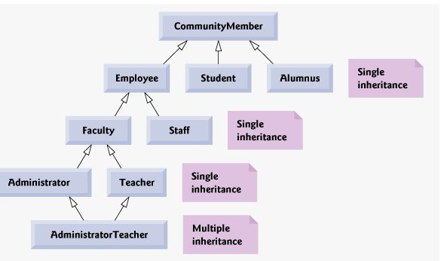
Inheritance - Example
CPS235:Inheritance

Slide 18
Inheritance
Features: a,b
a
b
Class A
Features: a,b,c
Features: a,b,d,e
c
d
e
Class B
Class C
Features: a,b,d,e,f
f
Class D
CPS235:Inheritance

Slide 19

Inheritance and Encapsulation
private member
  Is accessible only via the base class
public member
  Is accessible everywhere (base class, derived class, other classes)
protected member
  Is accessible by the base class and derived classes

Slide 20
Inheritance Concept
class Rectangle{
private:
int width, length;
public:
void set(int w, int l);
int area();
};
Polygon
Rectangle
Triangle
class Polygon
{
private:
int width, length;
public:
void set(int w, int l);
};
class Triangle{
private:
int width, length;
public:
void set(int w, int l);
int area();
};
CPS235:Inheritance

Slide 21
Inheritance Concept
class Polygon
{
protected:
int width, length;
public:
void set(int w, int l);
};
Polygon
Rectangle
Triangle
class Rectangle{
protected:
int width, length;
public:
void set(int w, int l);
int area();
};
class Rectangle: public Polygon
{
public:
int area();
};
CPS235:Inheritance

Slide 22
Inheritance Concept
class Polygon
{
protected:
int width, length;
public:
void set(int w, int l);
};
Polygon
Rectangle
Triangle
class Triangle{
protected:
int width, length;
public:
void set(int w, int l);
int area();
};
class Triangle : public Polygon
{
public:
int area();
};
CPS235:Inheritance

Slide 23
Inheritance Concept
class Point
{
protected:
int x, y;
public:
void set(int a, int b);
};
Point
x
y
Circle
3D-Point
x
y
r
x
y
z
class Circle : public Point
{
private:
double r;
};
class 3D-Point: public Point
{
private:
int z;
};
CPS235:Inheritance

Slide 24
Declaring Inheritance
Syntax:
class DerivedClassName : access-level BaseClassName
where
  access-level specifies the type of derivation
    private by default, or
    public or
    protected (used very rarely)
CPS235:Inheritance

Slide 25
Class Derivation
Point
class Point{
protected:
int x, y;
public:
void set(int a, int b);
};
3D-Point
Sphere
class 3D-Point : public Point{
private: double z;
… …
};
class Sphere : public 3D-Point{
private: double r;
… …
};
Point is the base class of 3D-Point, while 3D-Point is the base class of Sphere
CPS235:Inheritance

Slide 26
What to Inherit?
In principle, every member of a base class is inherited by a derived class
  just with different access permission
CPS235:Inheritance

Slide 27
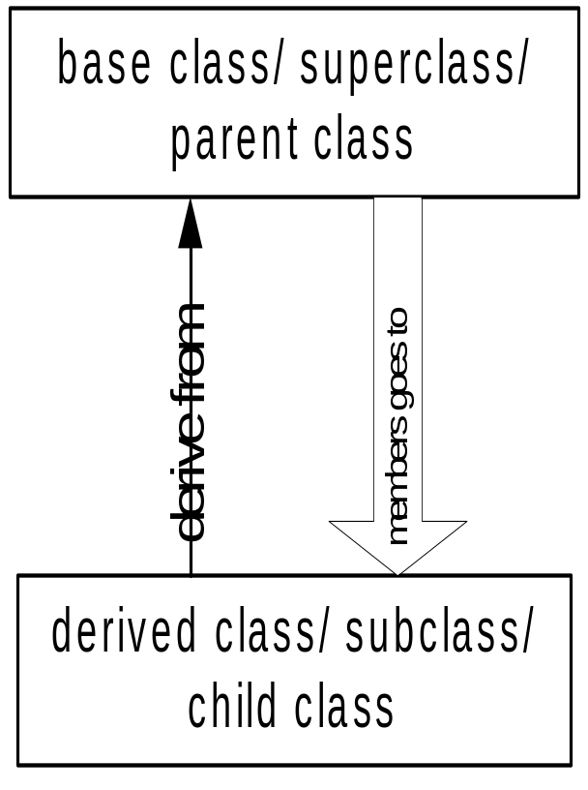
Access Control Over the Members
Two levels of access control over class members
  class definition
  inheritance type
class Point{
protected: int x, y;
public: void set(int a, int b);
};
class Circle : public Point{
… …
};
CPS235:Inheritance

Slide 28
Member Access Control
There are 3 levels of member (data or methods) access control:
  public: members can be used by itself and the whole world; any function can access them
  protected: methods (and friends) of itself and any derived class can use it
  private: members can only be used by its own methods (and its friends)
    We’ll study friend functions later
Without inheritance, private and protected have the same meaning
The only difference comes into play when inheritance is used, which is that methods of a derived class can access protected members of a base class, but cannot access private members of a base class
CPS235:Inheritance

Slide 29
public Inheritance Type
With public inheritance, the derived class follows the same access permission as in the base class, i.e.
  the private members of the base class are private in the derived class
  the protected members of the base class are protected in the derived class
  the public members of the base class are public in the derived class
Type of Inheritance
Access Control
for Members
 | private | protected | public
private | private | private | private
protected | private | protected | protected
public | private | protected | public

Slide 30
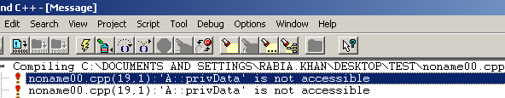
private Data Members (in public Inheritance)
class A
{
private:
int privData;
protected:
int protecData;
public:
int publicData;
};
class B: public A
{
public:
void funtion()
{
cout<<privData;
cout<<protecData;
cout<<publicData;
};
int main()
{
A a;
B b;
b.function();
return 0;
}
With all forms of inheritance, private members of a base class are not accessible directly from that class's derived classes, but these private base-class members are still inherited (i.e., they are still considered parts of the derived classes).

Slide 31
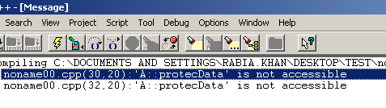
protected data Members (in public Inheritance)
int main()
{
A a;
B b;
cout<<a.protecData;
cout<<a.publicData;
cout<<b.protecData;
cout<<a.publicData;
b.function();
getch();
return 0;
}
With public inheritance, all other base-class members retain their original member access when they become members of the derived class (e.g., public members of the base class become public members of the derived class and protected members of the base class become protected members of the derived class).

Slide 32
private Inheritance Type
With private inheritance, none of the members of base class is accessible by the derived class
Type of Inheritance
Access Control
for Members
 | private | protected | public
private | private | private | private
protected | private | protected | protected
public | private | protected | public

Slide 33

protected and public data Members (in private Inheritance)
class A
{
private:
int privData;
protected:
int protecData;
public:
int publicData;
};
class B: private A
{
public:
void function()
{
cout<<protecData;
cout<<publicData;}
};
int main()
{B b;
cout<<b.protecData;
cout<<b.publicData;
b.function();
getch();
return 0;
}

Slide 34
protected Inheritance Type
With protected inheritance, only the public members inherited from the base class can be accessed in the derived class as protected members
Type of Inheritance
Access Control
for Members
 | private | protected | public
private | private | private | private
protected | private | protected | protected
public | private | protected | public

Slide 35
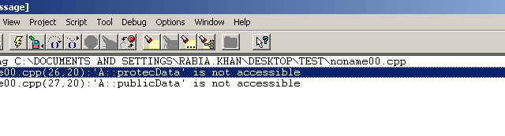
protected and public data Members (in protected Inheritance)
class A
{
private:
int privData;
protected:
int protecData;
public:
int publicData;
};
class B: protected A
{
public:
void function()
{cout<<protecData;
cout<<publicData;
}
};
int main()
{B b;
cout<<b.protecData;
cout<<b.publicData;
b.function();
getch();
return 0;
}

Slide 36
Access Rights of Derived Classes
Take these classes as examples:
  class B { /*...*/ };
  class D_priv : private B { /*...*/ };
  class D_prot : protected B { /*...*/ };
  class D_publ : public B { /*...*/ };
  class UserClass { B b; /*...*/ };
None of the derived classes can access anything that is private in B
In D_priv, the public and protected parts of B are private (not accessible outside class B)
In D_prot, the public and protected parts of B are protected (accessible inside class but not outside)
In D_publ, the public parts of B are public and the protected parts of B are protected (D_publ is-a-kind-of-a B)
CPS235:Inheritance

Slide 37
protected vs. private
So why not always use protected instead of private?
Because protected means that we have less encapsulation
  All derived classes can access protected data members of the base class
Assume that later you decided to change the implementation of the base class having the protected data members
  For example, we might want to represent address by a new class called Address instead of string
  If the address data member is private, we can easily make this change
  The class documentation does not need to be changed.
  If it is protected, we have to go through all derived classes and change them
  We also need to update the class documentation.
CPS235:Inheritance

Slide 38
Class Derivation Example
class daughter : public mother{
private:
double a;
public:
void foo ( );
};
mother
daughter
son
class mother{
protected:
int x, y;
public:
void set(int a, int b);
private:
int z;
};
void daughter :: foo ( ){
x = y = 20;
set(5, 10);
cout<<“value of a ”<<a<<endl;
z = 100; // error, a private member
};
daughter can access 3 of the 4 inherited members
CPS235:Inheritance

Slide 39
Class Derivation Example
mother
class son : private mother{
private:
double b;
public:
void foo ( );
}
daughter
son
class mother{
protected:
int x, y;
public:
void set(int a, int b);
private:
int z;
}
void son :: foo ( ){
x = y = 20;
set(5, 10);
cout<<“value of b ”<<b<<endl;
z = 100; // error, not a public member
}
son can also access 3 of the 4 inherited members
CPS235:Inheritance

Slide 40
Class Derivation Example
mother
class daughter : public mother{
private:
double a;
public:
void foo ( );
};
daughter
son
granddaughter
grandson
class mother{
protected:
int x, y;
public:
void set(int a, int b);
private:
int z;
};
class granddaughter : public daughter{
public:
void foo ( );
};
CPS235:Inheritance

Slide 41
Class Derivation Example
void granddaughter :: foo ( ){
x = y = 20; //OK
set(5, 10); //OK
cout<<“value of a “<<a<<endl; //error: private member of daughter
z = 100; // error, a private member of mother
};
CPS235:Inheritance

Slide 42
Class Derivation Example
mother
class son : private mother{
private:
double b;
public:
void foo ( );
};
daughter
son
granddaughter
grandson
class mother{
protected:
int x, y;
public:
void set(int a, int b);
private:
int z;
};
class grandson : public son{
public:
void foo ( );
};
CPS235:Inheritance

Slide 43
Class Derivation Example
void grandson:: foo ( ){
x = y = 20; //ERROR: not accessible
set(5, 10); //ERROR: not accessible
z = 100; // error, a private member of mother
};
CPS235:Inheritance

Slide 44
Encapsulation
class Figure
{
protected:
int x, y;
};
class Circle : public Figure
{
public:
int radius;
};
int main()
{
Circle a;
a.x = 0;
a.y = 0;
a.radius = 10;
}

Slide 45
Encapsulation
class Figure
{
protected:
int x_, y_;
};
class Circle : public Figure
{
private:
int radius_;
public:
Circle(int x, int y, int radius);
};
Circle::Circle(int x, int y, int radius)
{
x_ = x;
y_ = y;
radius_ = radius;
}
int main()
{
Circle a(0,0,10);
}

Slide 46

Encapsulation
class Figure
{
private:
int x_, y_;
};
class Circle : public Figure
{
private:
int radius_;
public:
Circle(int x, int y, int radius);
};
Circle::Circle(int x, int y, int radius)
{
x_ = x;
y_ = y;
radius_ = radius;
}
int main()
{
Circle a(0,0,10);
}

Slide 47
Encapsulation
class Circle : public Figure
{
private:
int radius_;
public:
Circle(int x, int y, int radius);
};
Circle::Circle(int x, int y, int radius)
{
SetX(x);
SetY(y);
radius_ = radius;
}
int main()
{
Circle a(0,0,10);
}
class Figure
{
private:
int x_, y_;
public:
void SetX(int x);
void SetY(int y);
};
void Figure::SetX(int x)
{
x_ = x;
}
void Figure::SetY(int y)
{
y_ = y;
}

Slide 48
What to Inherit?
In principle, every member of a base class is inherited by a derived class
  just with different access permission
However, there are exceptions for
  Base-class constructors, destructors and overloaded assignment operators are not inherited by derived classes. Derived-class constructors, destructors and overloaded assignment operators, however, can call base-class constructors, destructors and overloaded assignment operators.
Since all these functions are class-specific!
CPS235:Inheritance

Slide 49
Compulsory Reading
Robert Lafore
  Chapter 9: Inheritance
CPS235:Inheritance

